Slide 1
James Stone
President
Nor-Cal Guides and Sportsmen's Association
530-923-9440
jstone@ncgasa.org

Slide 2
Sacramento Fall Chinook Run Size
Sacramento Fall Chinook.
Year | Stock Forecast | Realized SI | Pre vs Post SI | Minimum Escapement Goal | Projected Escapement | Realized Escapement | pre vs post escapement
2009 | 122.2 | 41.1 | 2.97 | 122-180 | 122.05
2010 | 245.5 | 149.8 | 1.64 | 180 | 180 | 119.383 | 1.51
2011 | 729.9 | 207 | 3.53 | 180 | 377 | 119.342 | 3.16
2012 | 819.4 | 627.9 | 1.30 | 245.82 | 455.8 | 285.429 | 1.60
2013 | 834.2 | 869.3 | 0.96 | 250.3 | 462.6 | 406.846 | 1.14
2014 | 634.7 | 551.2 | 1.15 | 190.4 | 314.7 | 212.476 | 1.48
2015 | 652 | 254.9 | 2.56 | 195.6 | 341 | 113.468 | 3.01
2016 | 299.6 | 205.3 | 1.46 | 122 | 151.1 | 89.699 | 1.68
2017 | 230.7 | 137.1 | 1.68 | 122 | 133.2 | 44.329 | 3.00
2018 | 229.4 | 220.4 | 1.04 | 151 | 151 | 105.466 | 1.43
2019 | 379.6 | 507.1 | 0.75 | 160 | 160.2 | 163.767 | 0.98
2020 | 473.2 | 352.5 | 1.34 | 142 | 233.2 | 138.091 | 1.69
2021 | 271 | 322.7 | 0.84 | 122 | 133.9 | 105.584 | 1.27
2022 | 396.5 | 251.2 | 1.58 | 180 | 198.7 | 61.862 | 3.21
2023 | 169.8 | 139.5 | 1.22 | 122 | 164.96 | 133.638 | 1.23
2024 | 213.606

Slide 4
High Error Rate in Predicted Sacramento Escapement

Slide 5
Table B-1. Sacramento River Fall Chinook escapement, 1970 - 2023

Slide 6
647 jacks
2023
430 jacks

Slide 11
Recreational Fishing Decline since 2010

Slide 12
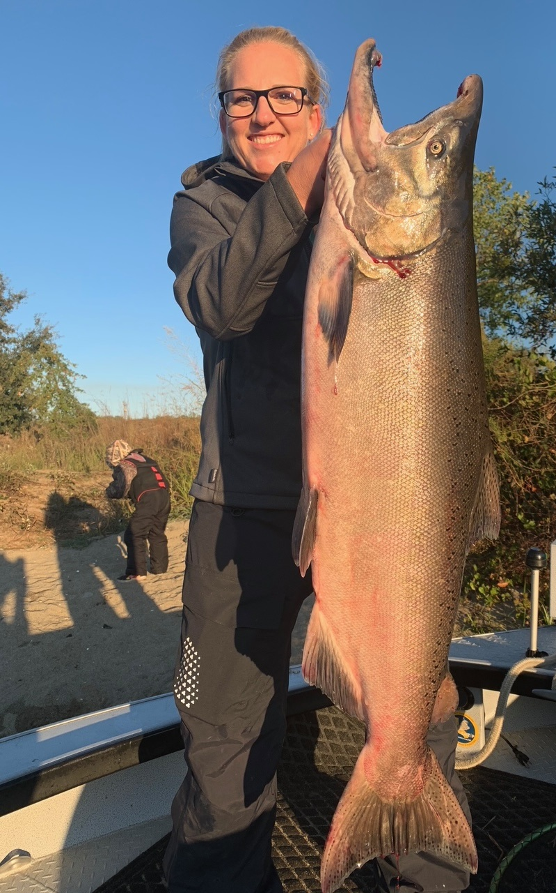
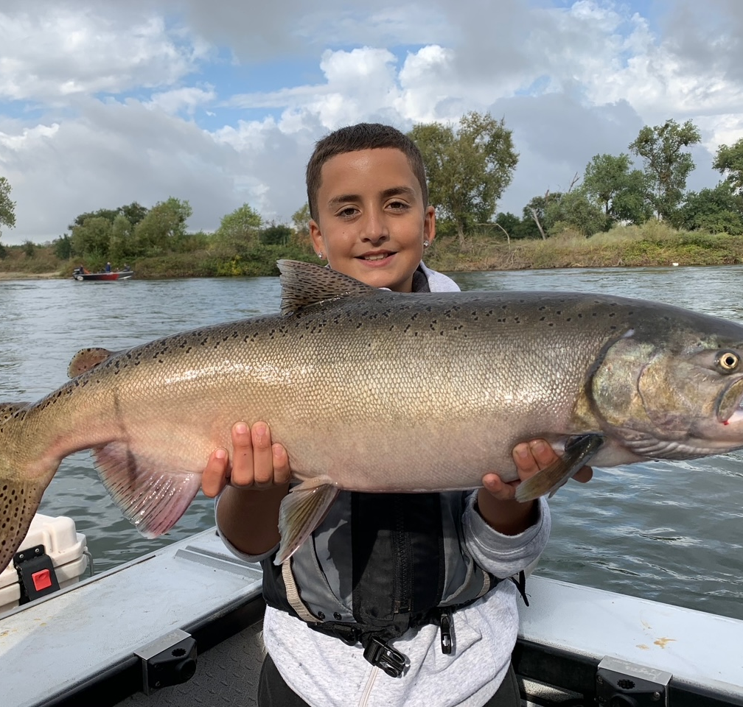
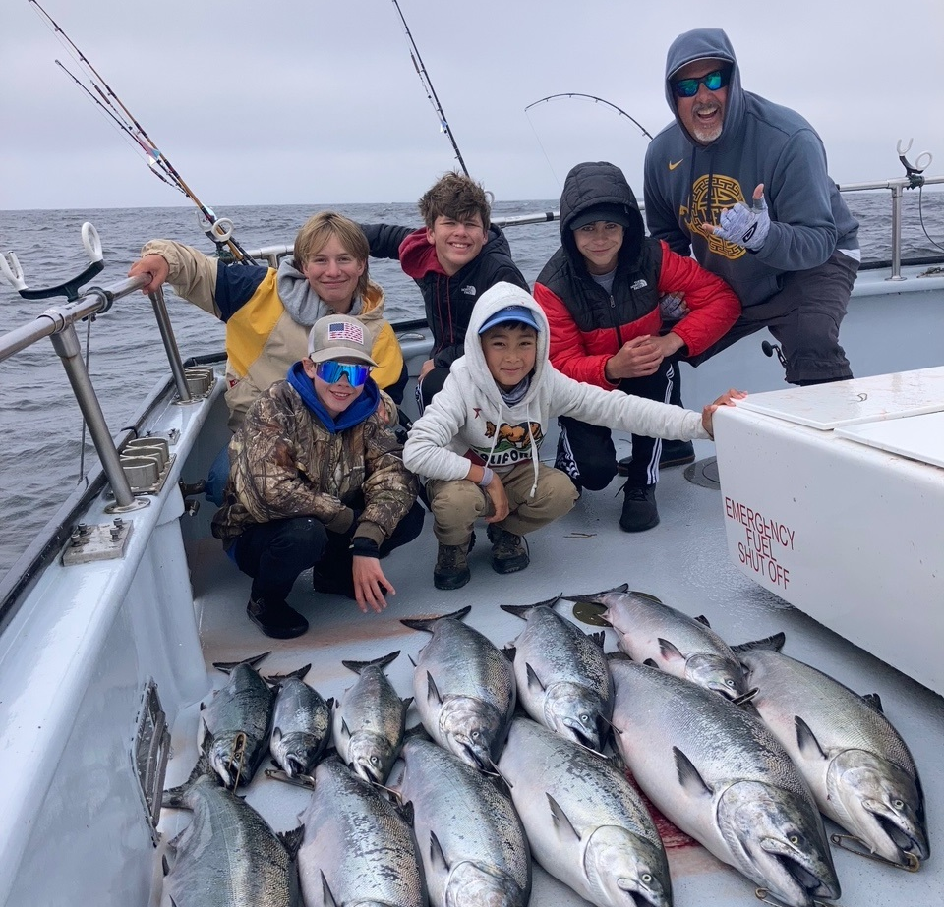
SUMMARY
MODEL SUSTAINABILITY
LONG TERM ACCESS FISHERY
PROPER SPECIES MANAGEMENT
(Escapement)
R3/ANGLER ENTHUSIASM/YOUTH

